Slide 1
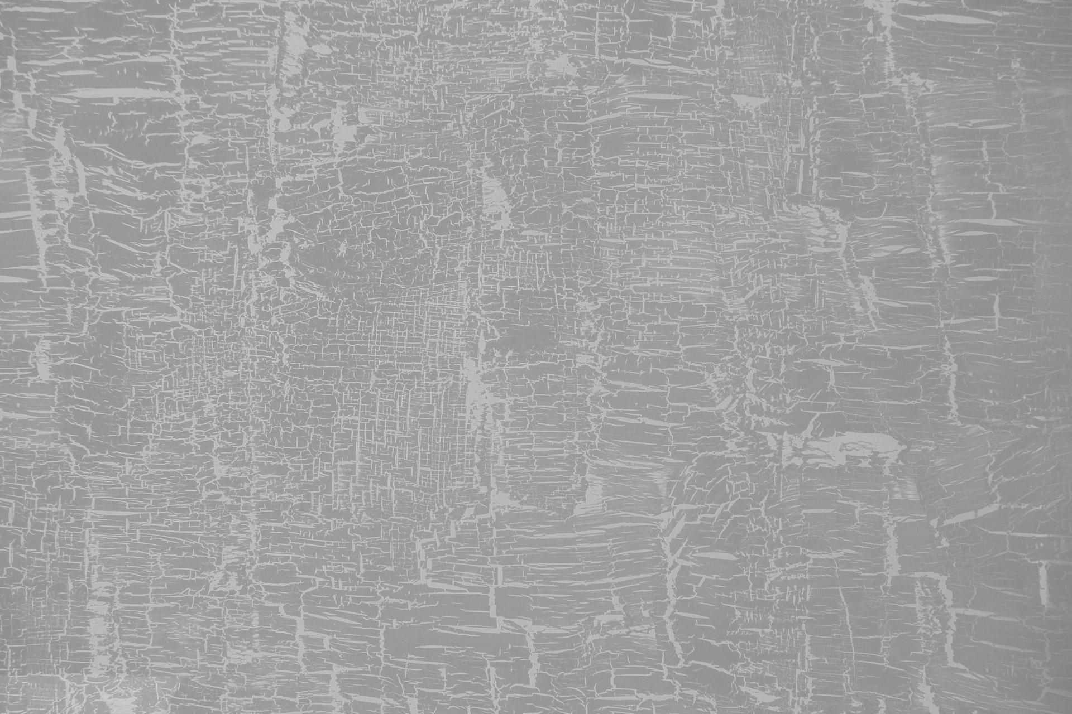
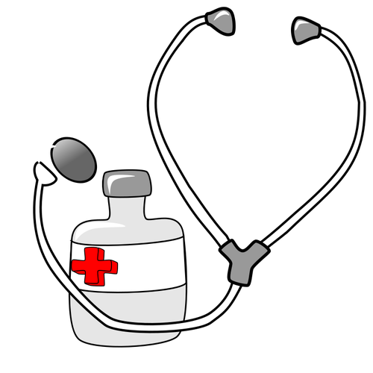
Axis Insurance Dataset
ANISAH INUA MOHAMMED

Slide 2


Objective
To extract actionable insights from the data and perform a statistical analysis.
Prove (or disprove) that the medical claims made by the people who smoke is greater than those who don't
Create Null and Alternate Hypothesis

Slide 3
Data Information
The data contains information about people and their medical insurance and what factors contribute to the charges on their medical insurance.
Variables | Description
age | Age of the primary beneficiary
sex | Insurance contractor gender, female or male
BMI: | Body Mass Index, understanding of the body weights
Children | Number of children covered by healthcare insurance or number of dependants
smoker | Smoking or not
region | the beneficiary's residential area in the US, northeast, southeast, southwest, northwest
Charges | Individual medical costs billed by health insurance
Note:
There are no missing values in this dataset
There are no null values in this dataset

Slide 4


Exploratory Data Analysis

Slide 5
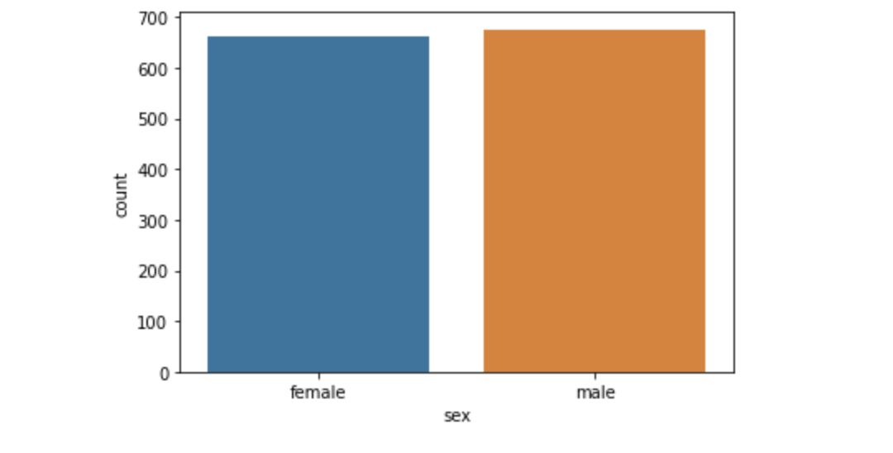
Gender
From this countplot it reveals the percentage of data in gender. This shows that the percentage of male is slightly higher than the female in this dataset.

Slide 6
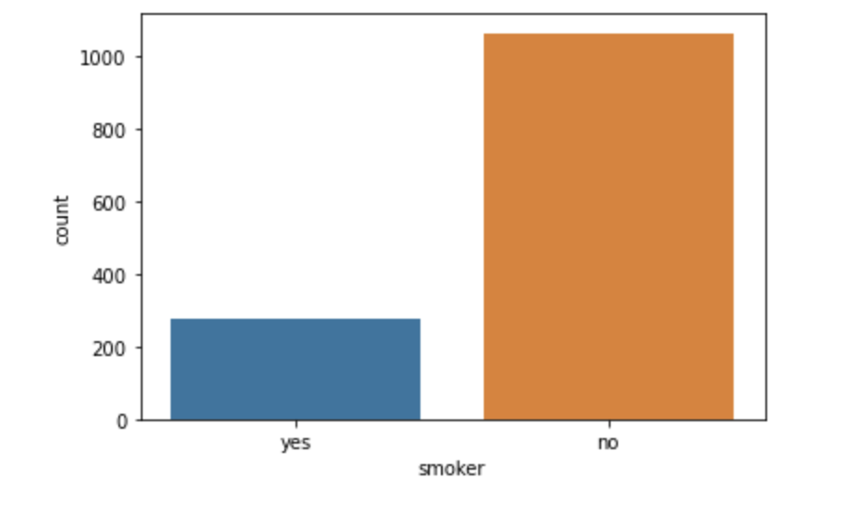
Smoking
This is checking the percentage of smokers in the dataset. This reveals that there are more non-smokers in this dataset.

Slide 7
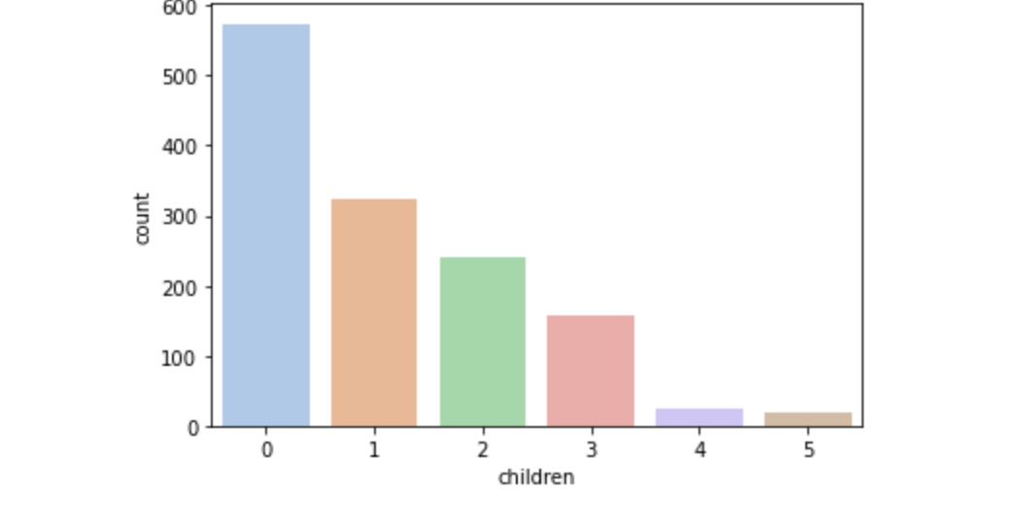
Children
This is a countplot showing the amount of children each primary beneficiary in this dataset has and this has revealed that most most people in this dataset have no children while less than 100 people in this dataset have 4-5 children in this dataset.

Slide 8
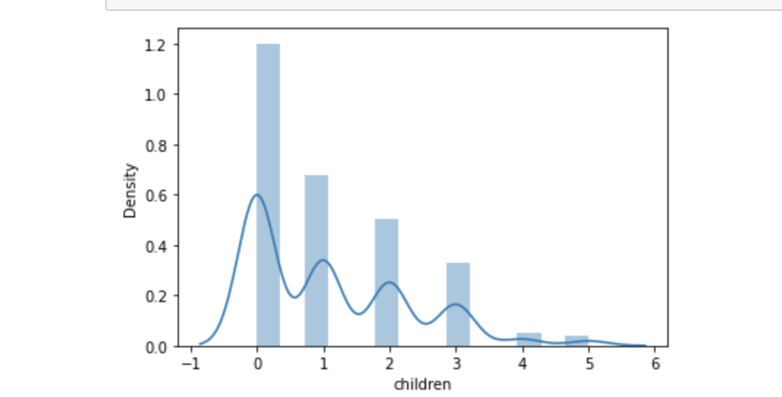
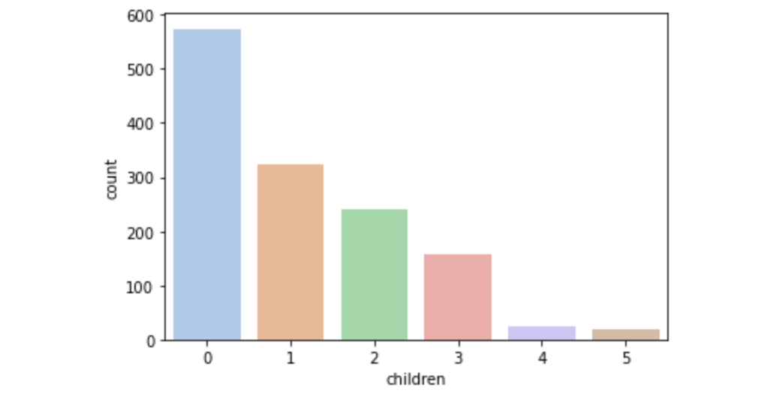
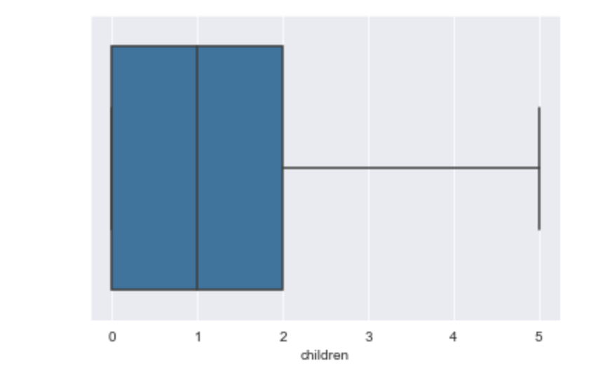
Children
This reveals that the graph is rightly skewed with a long tail.
it can be deduced that less than 100 people in this dataset have up to 4 or 5 children. While the majority of the dataset have 0 children.

Slide 9
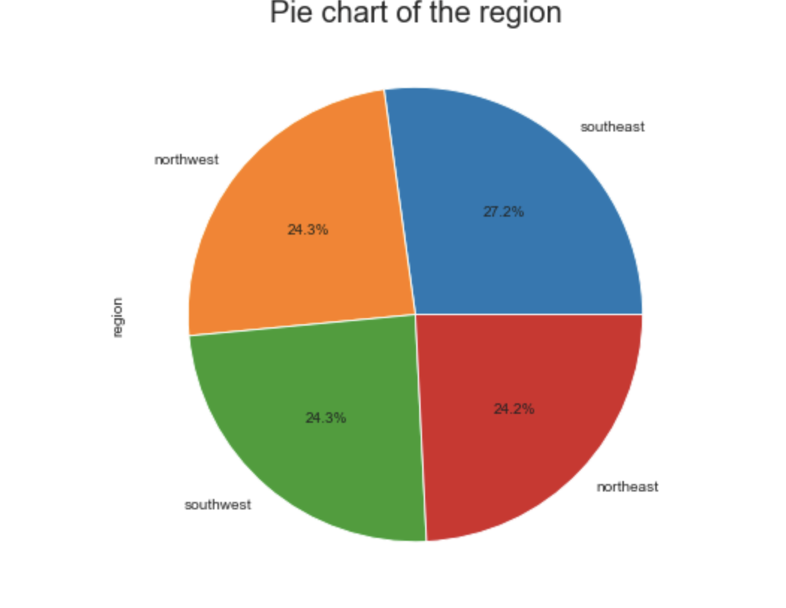
Region
This is a pie chart of the percentage of the region which was used most from the dataset. This displays that most beneficiaries were from the Southeast.

Slide 10
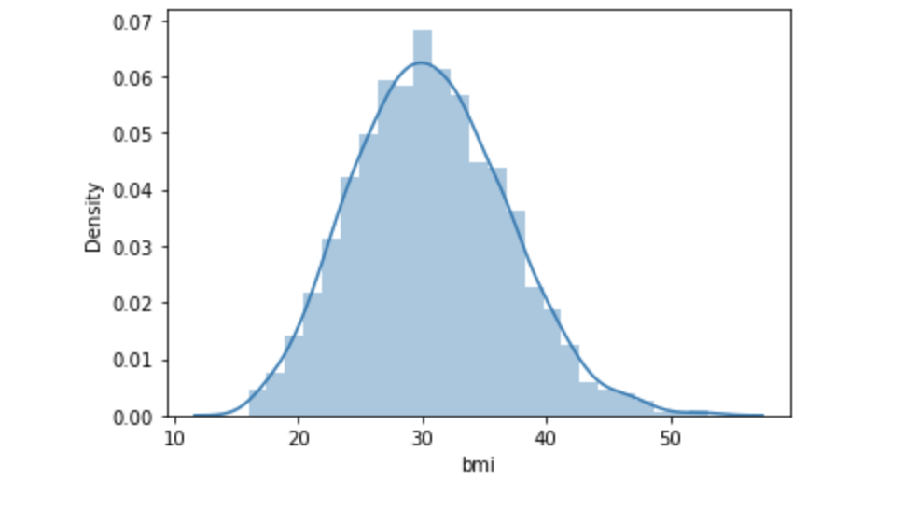
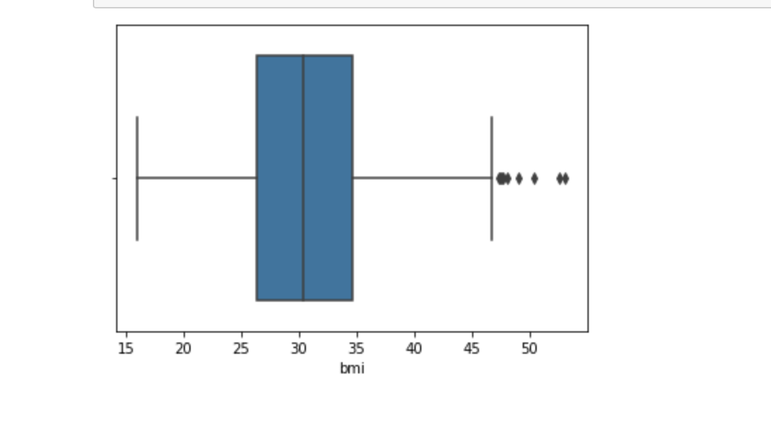
BMI
The graph displayed above shows that the bmi could be normally distributed.

Slide 11
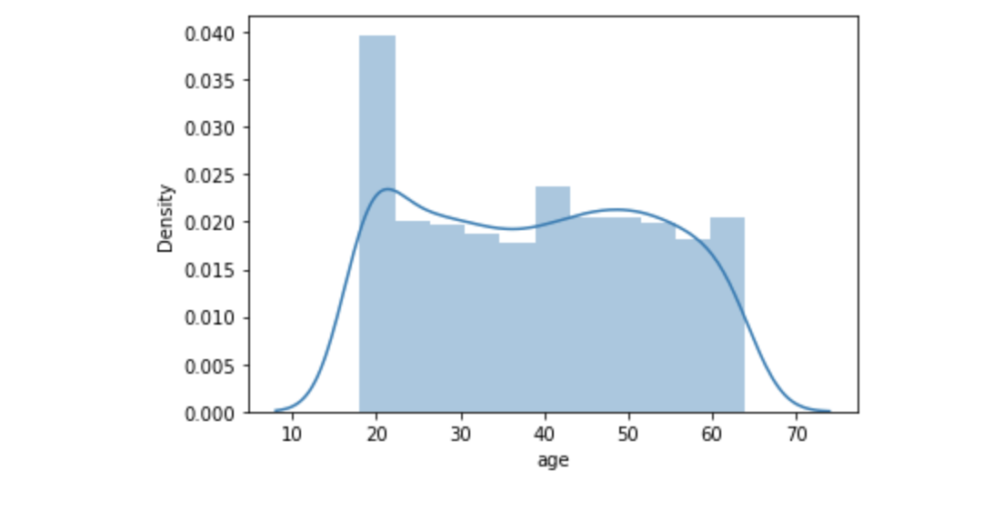
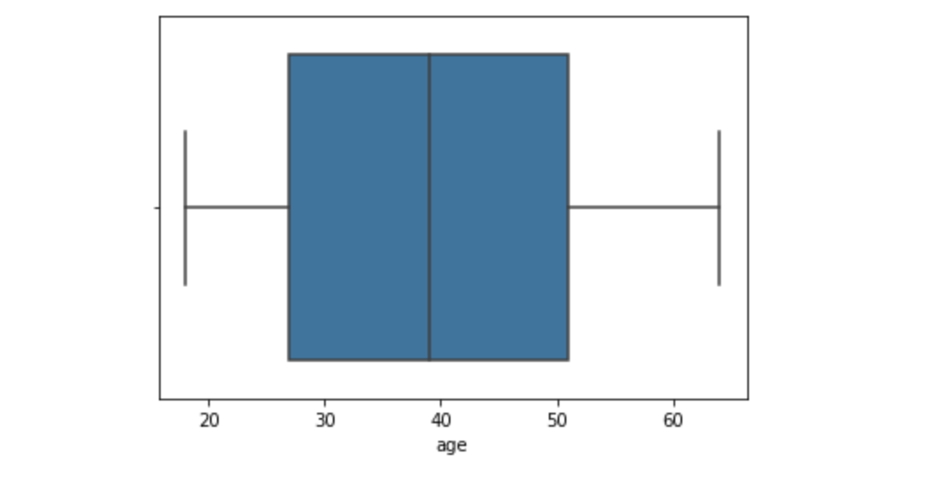
Age
This shows a boxplot of Age which reveals that there are no outliers in the age column.
However, the distplot reveals that there are a lot people in the age range of 20.

Slide 12
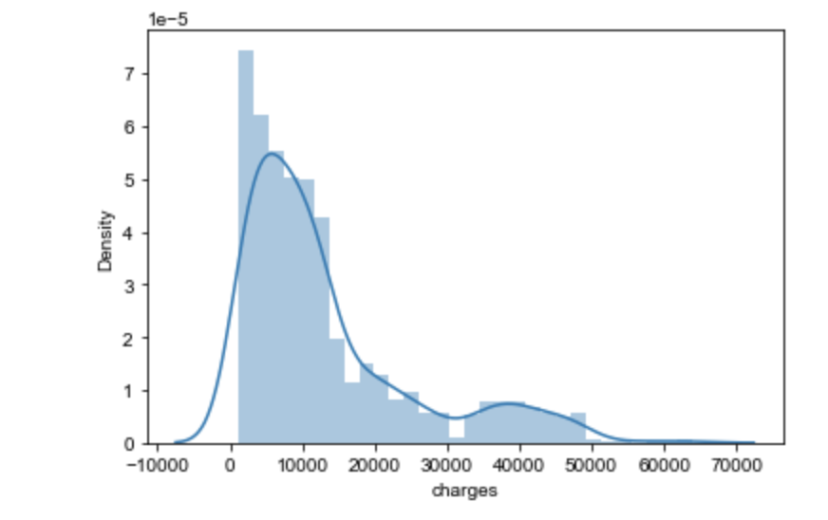
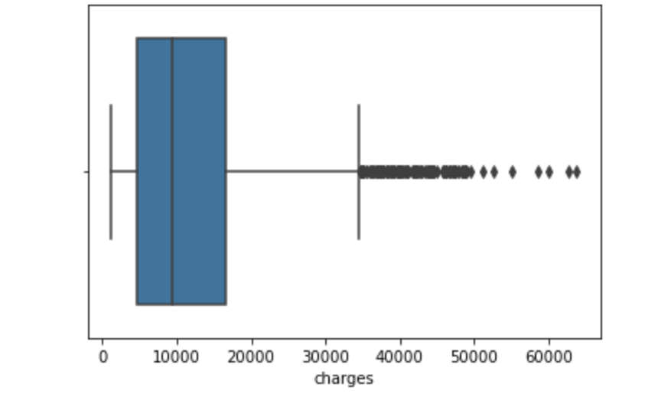
Charges
From the graph it is evident that there are outliers in the 'charges' column.
The graph shows that the charges are rightly skewed when the long tail is at the right side which explains that the mean is greater than the median (mean>median).
Also the medical charges are more under the range from 0-15000

Slide 13
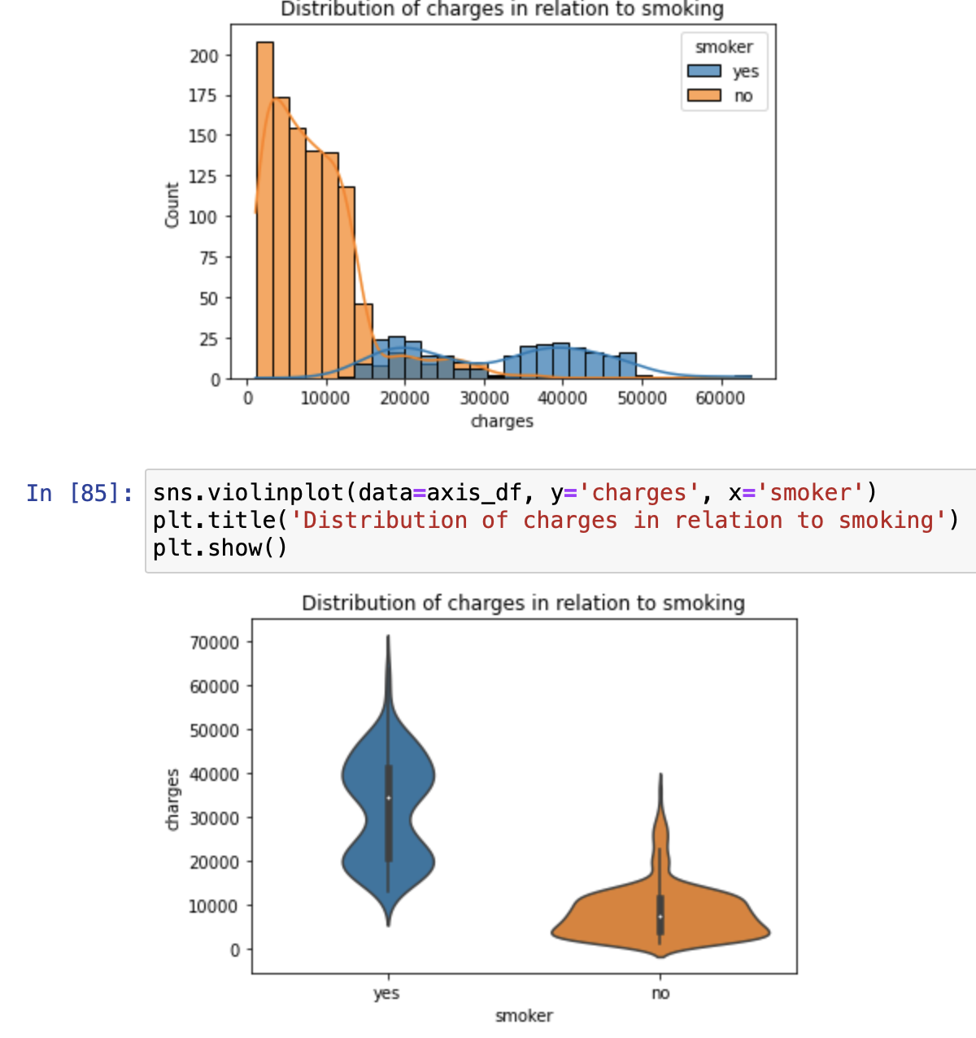
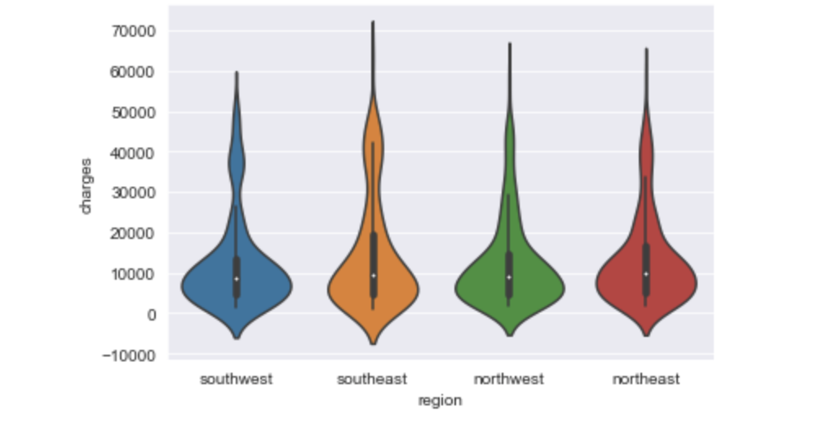
Charges in relation to Smoking, Sex and Regions
From the dataset is quite unequal when it comes to the 'smoker' column. However, it displays that generally smokers will incur more charges than non-smokers

Slide 14
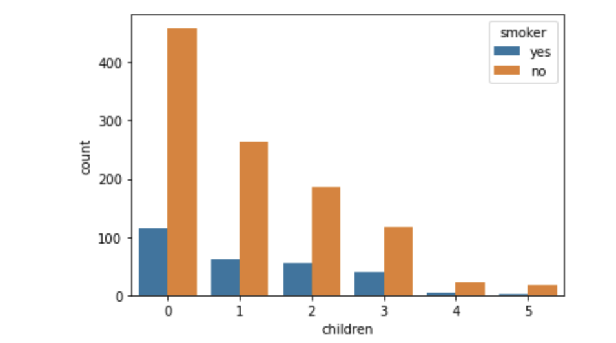
Children in relation to Smokers
From the the graph is displays that 459 non smoking people have 0 children while 115 smokers have 0 children.
263 non smokers have the total of 1 child and 61 smokers have a total of 1 child.
17 nonsmokers have an amount of 5 children.
While 1 smoking person has a total of 5 children in the dataset.

Slide 15
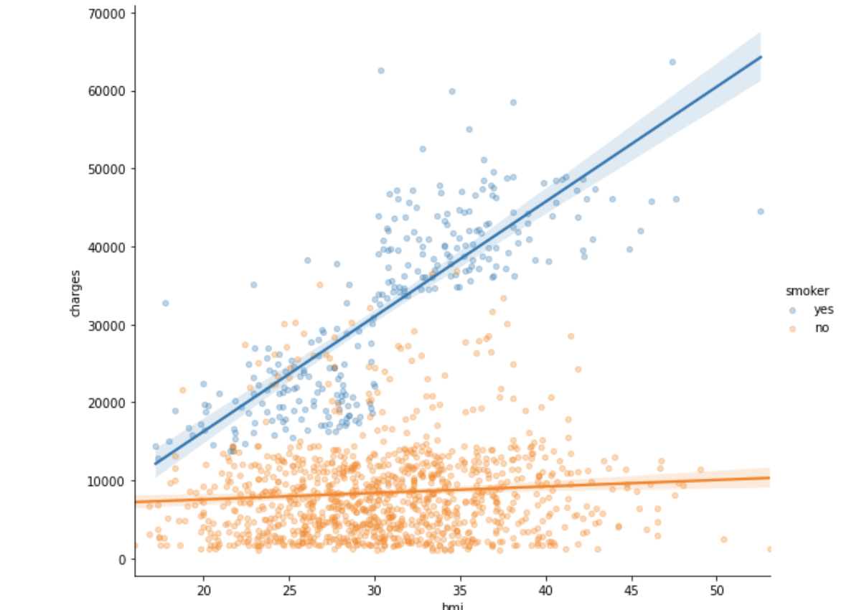
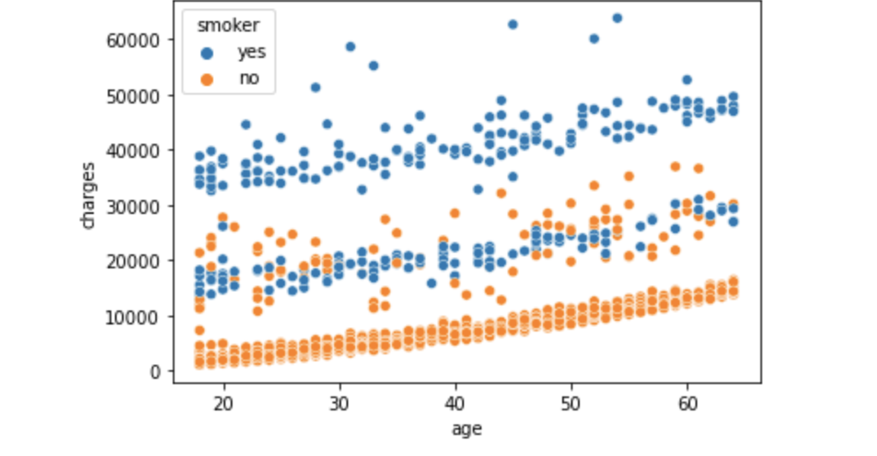
BMI, Charges and Smoking
This scatter plot it reveals that may not always be the case and an instance could be given according the level of social class or poverty level.

Slide 16
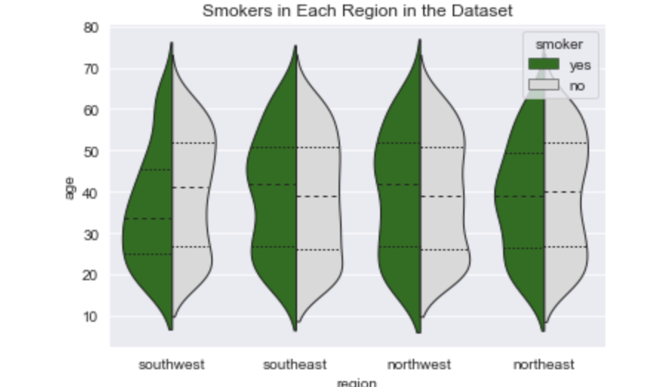
Age, Smoker, Region
This reveals that number of smokers are lower from the range 40 - 80 of age in the south west region

Slide 17
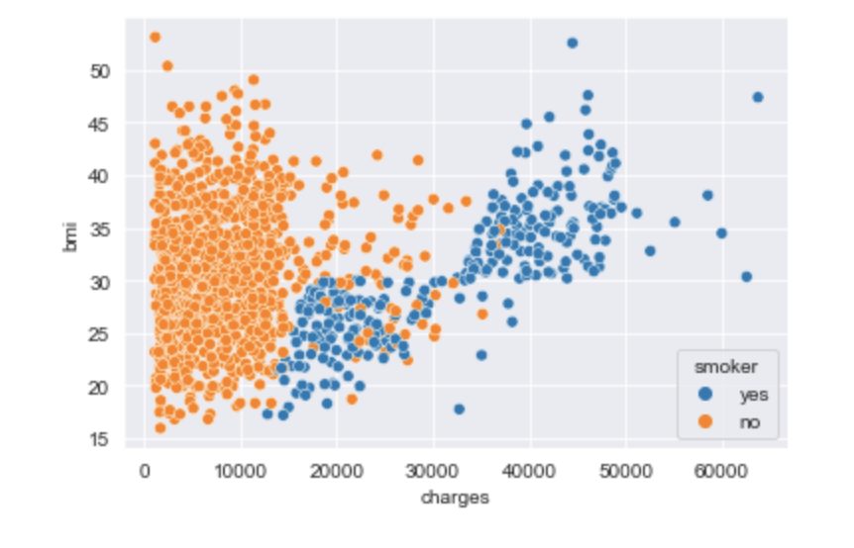
BMI, Charges, Smoker
The graph is displaying BMI in accordance to charges and this shows that there are more non smokers that have BMI in the range of 15-40 within the range from 0-15000 in charges, while the smokers incur more charges that move in a linear form from 15-50 BMI range.

Slide 18
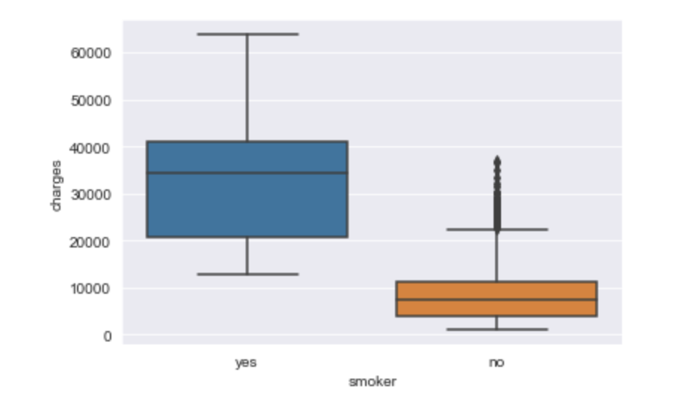
Charges and Smokers
From this box plot was created to check if there was a significant effect with smoking and charges.
This reveals that there is a significant effect with charges and smoking.
This means smokers influence charges.

Slide 19
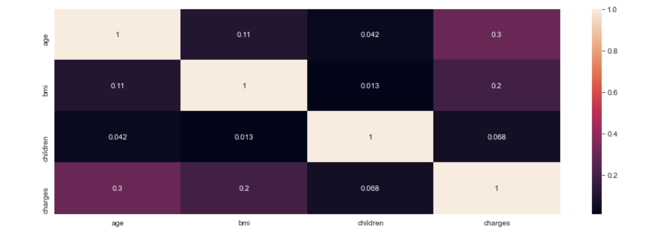
Heatmap
Charges is a bit correlated to age
Most of these columns are not positively correlated.

Slide 20
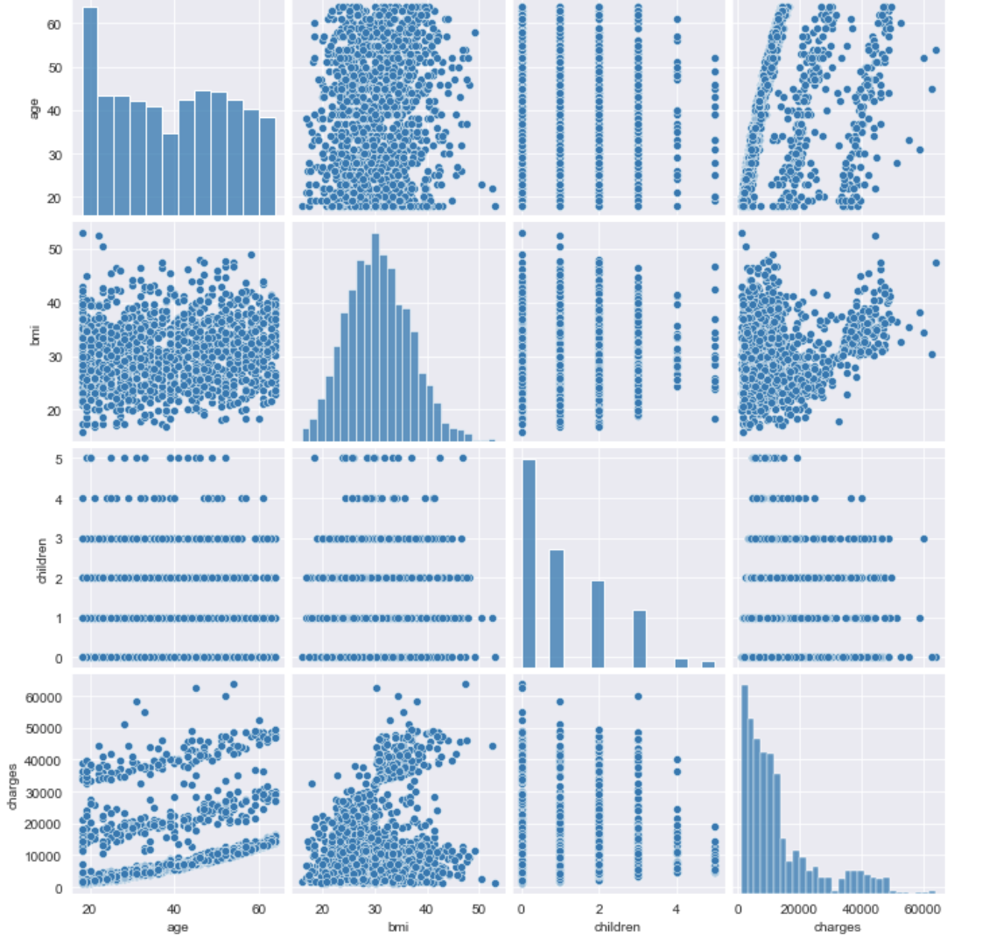
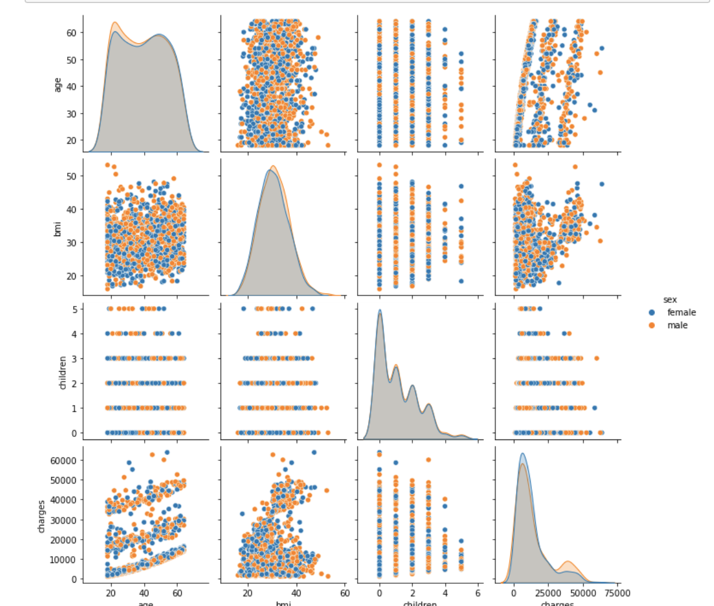
Pairplot

Slide 21
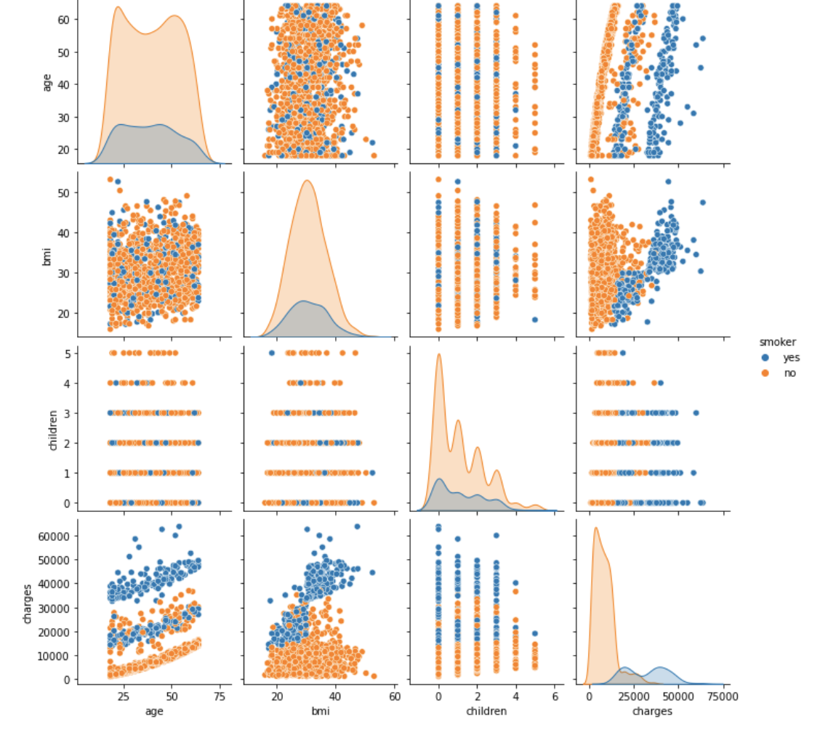
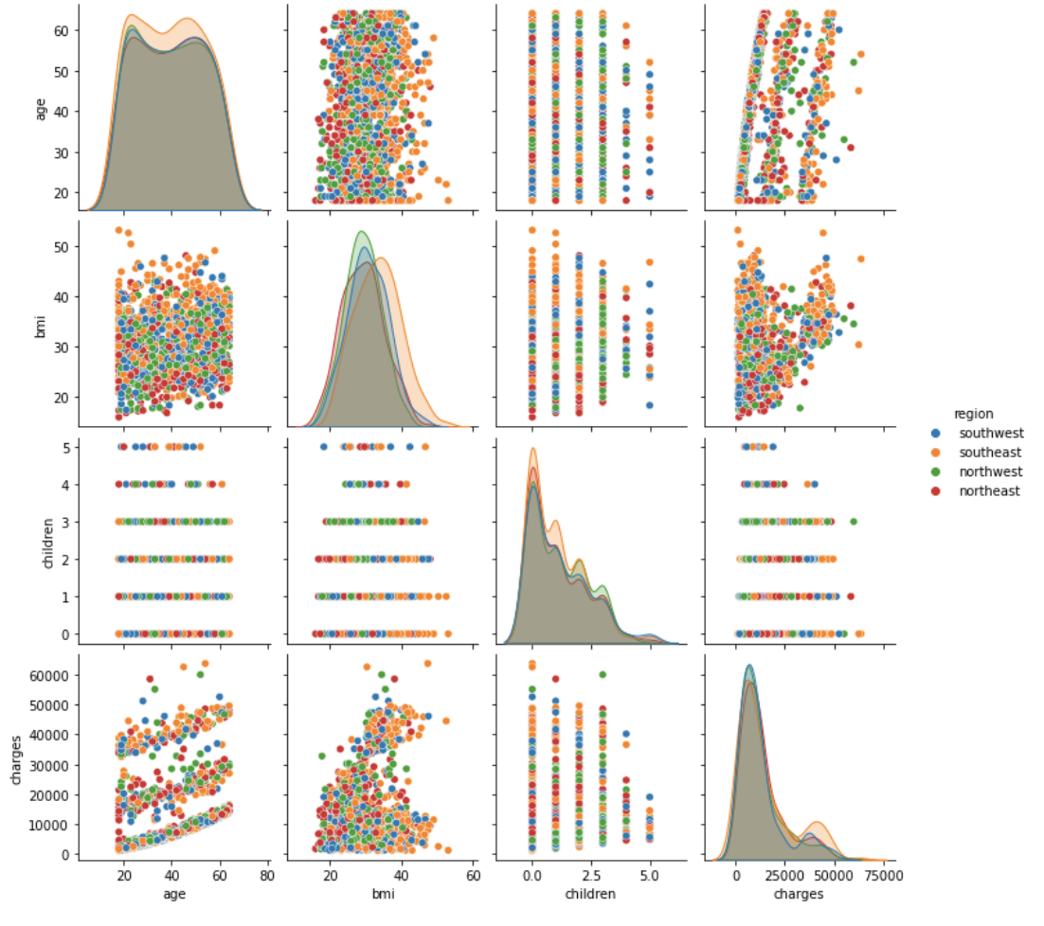

Slide 22

General Observation
From the above graphs we can deduce that varying distributions in variables for different columns, hence further investigation would be carried out

Slide 23
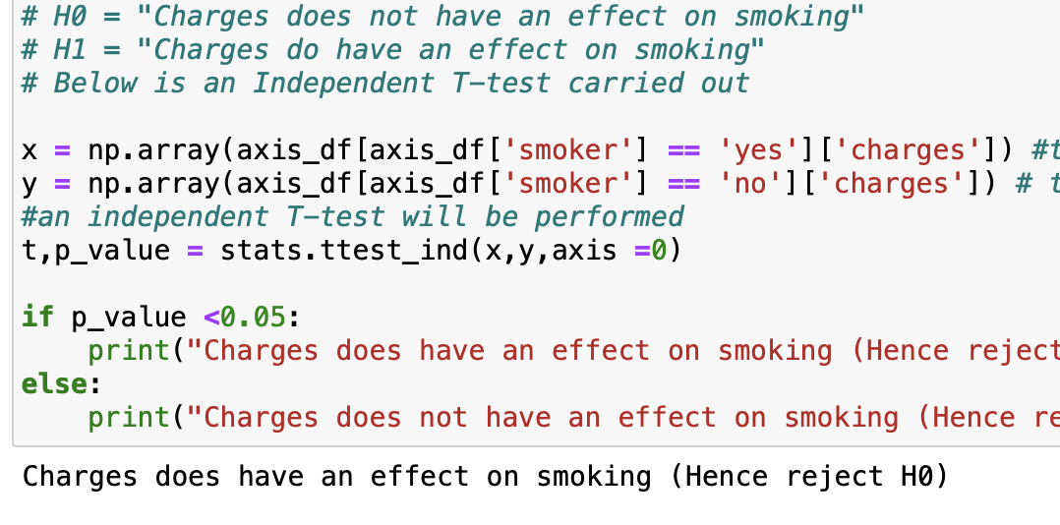
Question: Does the medical claims made by the people who smoke is greater than those who do not?
This would mean that do the charges of people who smoke have a significant difference from those who do not smoke
Null Hypothesis -> H0 = "Charges does not have an effect on smoking"
Alternate Hypothesis -> H1 = "Charges do have an effect on smoking"
From the code is measuring with an independent whether smoking has an effect on charges with the significance level of 0.05. After the check it reveals that Charges does have an effect on smoking. Therefore, we reject the Null Hypothesis.

Slide 24
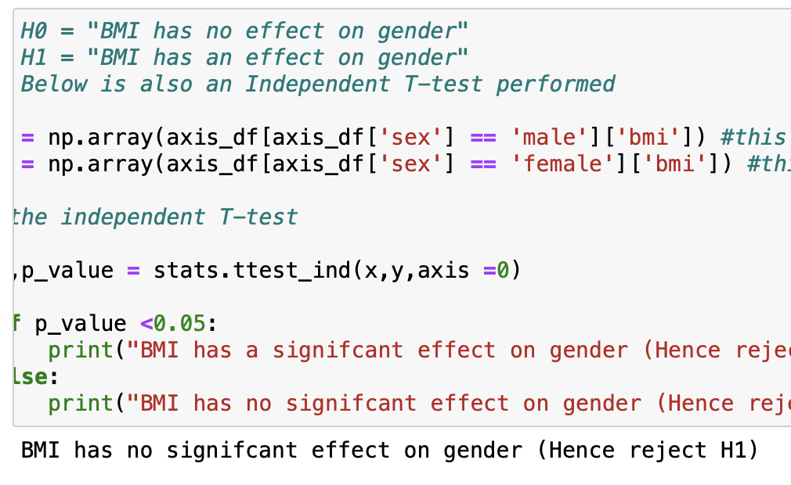
Question: Does the BMI of the females differ from that of males?
This question is posed to understand if the BMI of males have a significant difference from that of females.
Null Hypothesis -> H0 = "BMI has no effect on gender"
Alternate Hypothesis -> H1 = "BMI has an effect on gender"
This is a test to check whether BMI has an effect on gender or not and using an independent t-test it reveals that BMI has significant effect on either gender.

Slide 25
Question: Is the proportion of smokers significantly different across different regions?
This is to display if there is a significant difference between proportion of smokers with regards to gender.
Null Hypothesis -> H0 = "There is no significant difference in proportion of smokers in the different genders"
Alternate Hypothesis -> H1 = "There is significant difference in the proportion of smokers in the different genders"
A chi square will be performed because of this will check all four types of outcome which is:
a female and a smoker
a female and a non smoker
a male and a smoker
a male and a non smoker

Slide 26

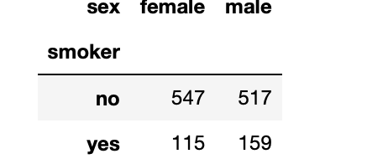
Before the chi-square is performed, a crosstab is performed because they are both categorical values

Slide 27
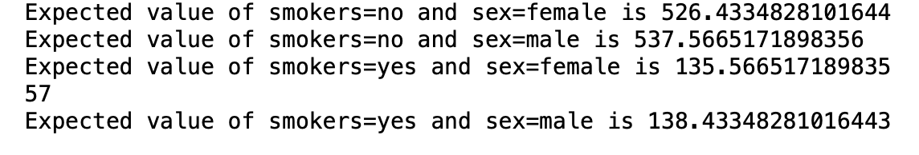
We will start with the males. This reveals that 517 are non smokers and 159 males are smokers
From the above crosstab it reveals that 547 females are non smokers and 115 females are smokers
E represents the column for smokers
E20 = expected values of smokers=no and sex = female
E21 = expected values of smokers=no and sex = male
E30 = expected values of smokers=yes and sex = female
E31 = expected values of smokers=yes and sex = male
E = total of smokers or non smokers * (total of male or female / total of the genders)
This is a calculation of outcomes possible in this dataset

Slide 28
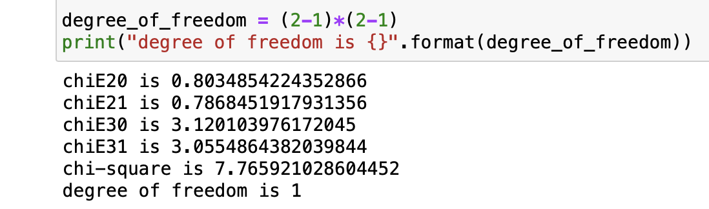
Chi-square will now be performed
The formula that will used is : summation((observed outcome - expected outcome)^2/expected outcome)
Degree of freedom is also calculated to find the number of maximum number of logically independent values, which are values that have the freedom to vary in the dataset

Slide 29
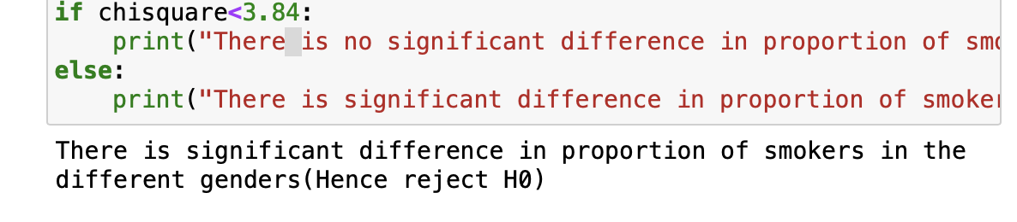
After calculating the chi-square value and the degree of freedom, the focus will now be on the chi square
The table will be created and used to check if the chi-square statistics of 7.76 surpasses the critical value of the chi-square distribution, where the significant value is 0.05 (which is 95% of the confidence level) which is 3.84
It is obvious that it more than 3.84 therefore we have to reject the null hypothesis which is H0
From the Chi-square test it shows that there is significant proportion of smokers in the genders.
This could mean that smoking has an effect on gender in this dataset.

Slide 30
Question: Is the mean BMI of women with no children, one child and two children the same?
Null Hypothesis -> H0 = The mean of bmi of women with no children, one child and two children is not the same
Alternate Hypothesis -> H1 = The mean of bmi of women with no children, one child and two children is the same
This means we have to make the data frame of females having children <=2
Since we are using one independent variable "bmi", this means we can use one-way anova to do the this statistical test for improved results.

Slide 31
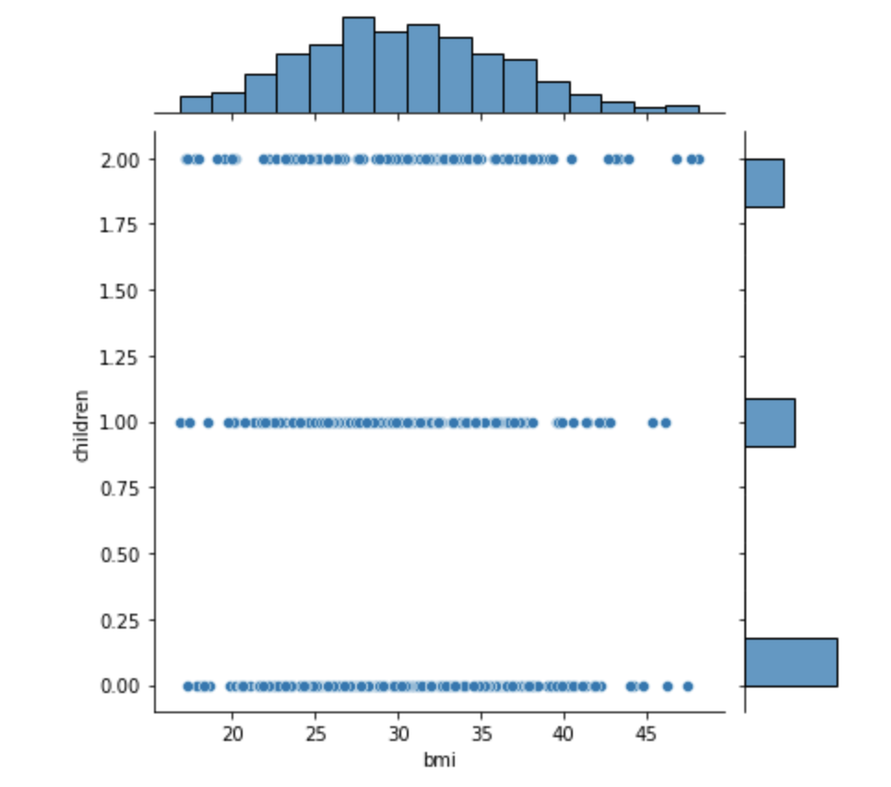
Jointplot
Since we are using one independent variable "bmi", this means we can use one-way anova to do the this statistical test for improved results.
Since the above diagram is not completely clear and does not exactly display the p_value which would show the mean of the bmi of women with no children, one child and two children the same to either reject or accept the Null Hypothesis
Hence, in order to receive a clearer description a One-way Anova was performed.

Slide 32
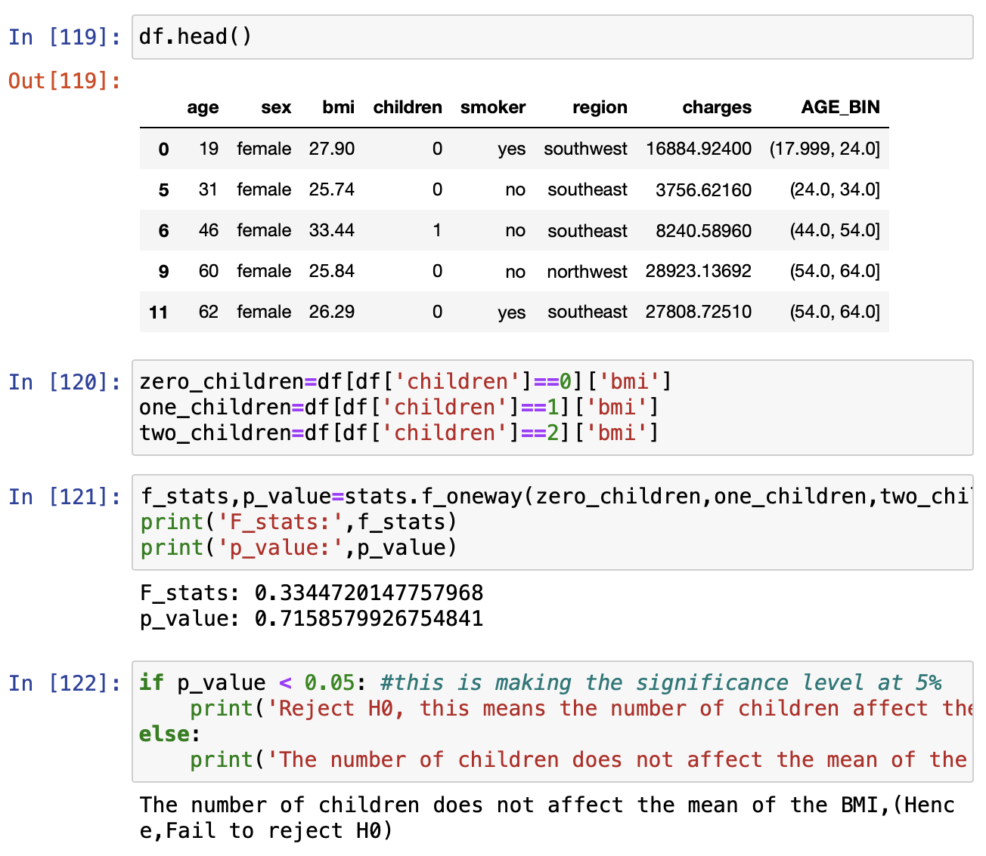
Analysis
The df.head was to show the new rows after only having females in the dataframe.
The anova is to check whether the mean BMI of women with no children, one child and two children the same?
After the p_value has been found it is used to check whether number children has a significant effect on the mean of BMI.
And the significance value is set at <0.05. While the p_value is 0.716. This shows that the p_value is not less than the the significance value.
Hence, the number of children does not affect the mean of the BMI therefore, we fail to reject the Null Hypothesis whis is H0.

Slide 33

Conclusion
From EDA and Feature importance plots we observed that Charges are merely dependent On Smoking,Body Mass Index,Age,Children
The people who smoke will definitely incur more medical charges
People who have high BMI will also face high medical Charges
The number of children a person has will also have an impact on medical charges
The higher the age, the higher the medical charge
The amount of children a person has does not affect a person's BMI

Slide 34

Thank You!
Anisah Inua Mohammed

